Slide 1
TruBudget Trusted Budget Expenditure A blockchain-based workflow tool for a transparent and collaborative use of public funds Piet Kleffmann General Assembly of ALIDE May 2019, Madrid

Slide 2
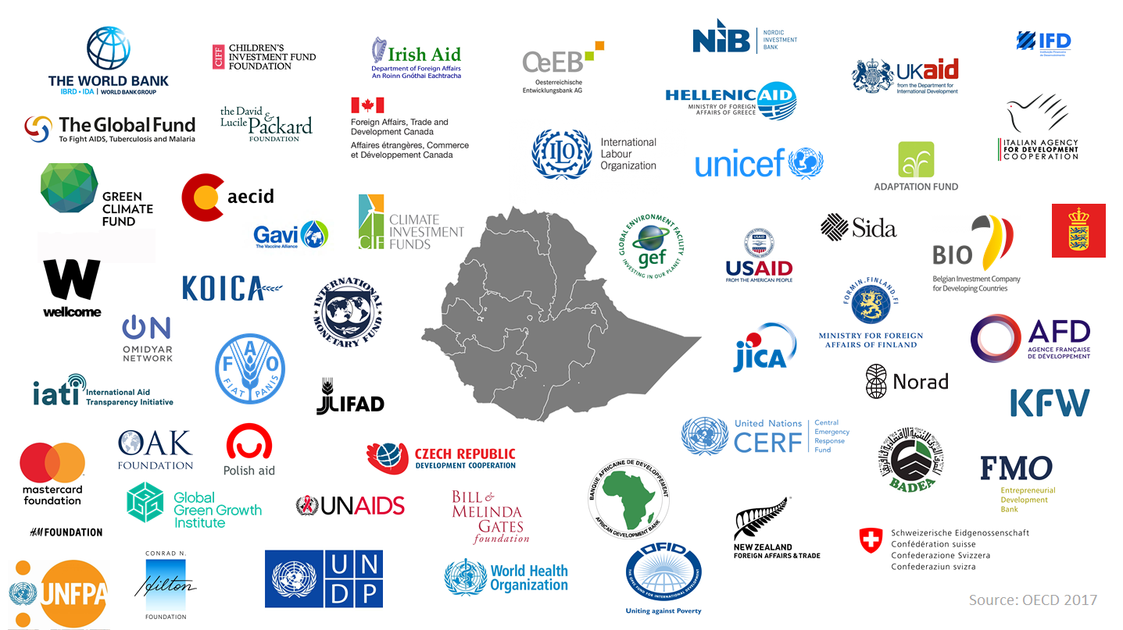
The challenge of donor harmonisation: example Ethiopia

Slide 3
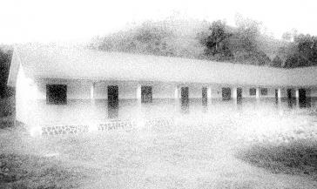
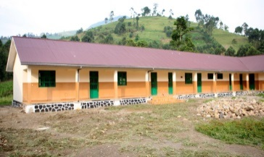
The challenge of partner systems
Fiduciary risks
Public Revenues
Donor Support
Lack of coordination
Public Budget
Project Budget
Voiding subsidiarity
Public Expenditure
Project Expenditure
High transaction costs
Limited Impact

Slide 4
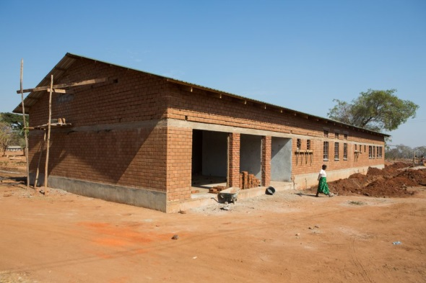
The challenge of communication and data
Unequal information level
Random and scattered filing
Redundant structures
Diverging data
No real-time data
Donor
Ministry of
Finance
Donor
Ministry of Education
Donor
Central
Bank
Disjunct data systems

Slide 5
TruBudget: a joint platform of collaboration and expenditure control
TruBudget Platform
Allocation budget lines
projects sub-projects
Implementation tender
contracts
reports
Disbursements payments
workflow
Donor
Ministry of
Finance
Donor
Ministry of Education
Donor
Central
Bank

Slide 6
TruBudget assets
control the use of external funds
channel donor funds through national budget
get real-time information on use of donor funds
improve communication and simplify decision-making
improve budget planning and macro-economic analysis
significantly reduce transaction costs
… while keeping your running IT-systems!

Slide 7
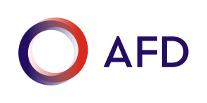
TruBudget Pilots
Georgia
Burkina Faso
Ethiopia

Slide 8
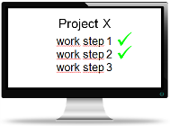
Generic principle of TruBudget: What do you need to coordinate amongst your partners?
Documents
Access by internet
Distributed
Covenants
Payments
Transparent
Private Blockchain
Decisions
Supply Chain
?
Open Source
Tamperproofed

Slide 9
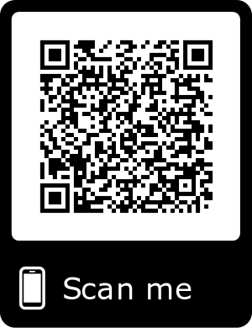
TruBudget Trusted Budget Expenditure Check out our Fact Sheet
Thank You

Slide 10
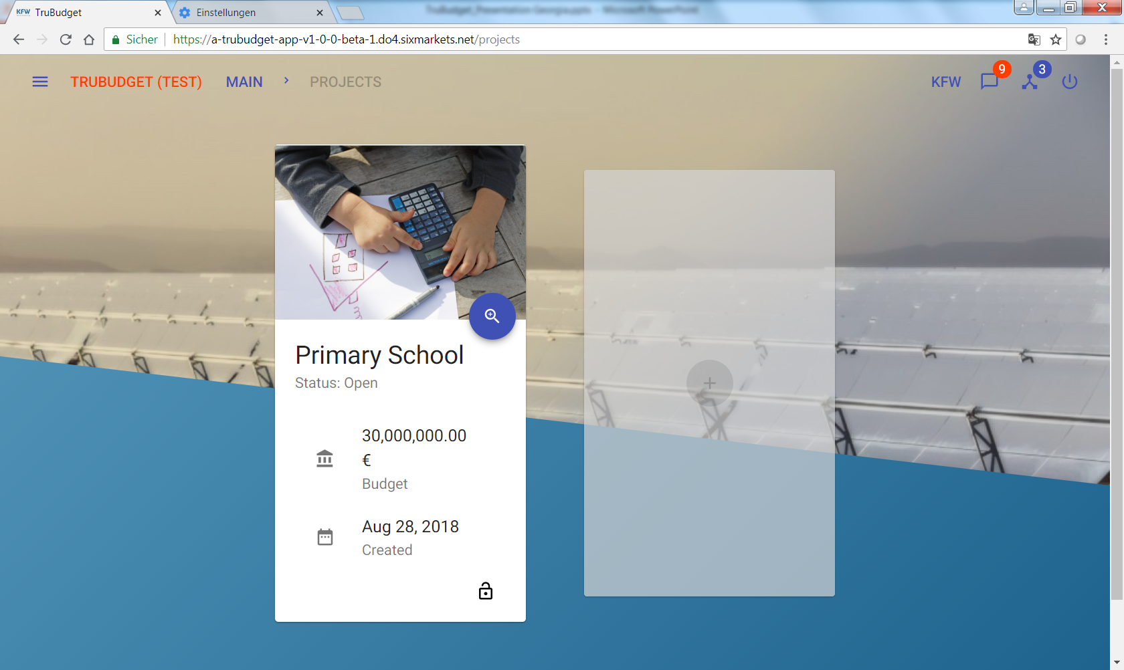
Selected stakeholder with specific rights

Slide 11
Easy to use, adaptable workflows

