Slide 1
Blended Finance: Movilizando recursos para la financiacion de proyectos con alto impacto de desarrollo Experienca del BEI

Slide 2
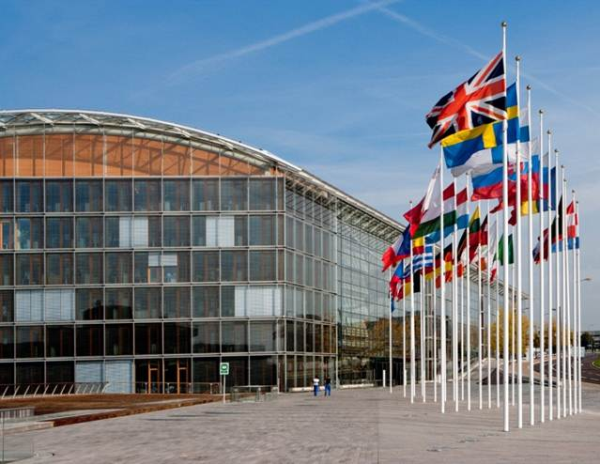
EIB: the bank of the European Union
The EIB is the EU's bank for long-term lending operations. The EIB's remit is to contribute towards the integration, balanced development and economic and social cohesion of the EU Member States.
Since 1963, the EIB has also carried out operations outside the EU in support of the EU’s external policies.
Established in 1958 by the Treaty of Rome. The shareholders of the Bank are the EU's Member States.
The largest multilateral lender and borrower in the world.
The Bank raises its resources by borrowing on the capital markets.
It passes on its favourable borrowing terms to its customers.
Some 450 projects are financed each year, in over 160 countries.
The EIB's headquarters are in Luxembourg supported by 40 local offices worldwide, about half of it outside the EU.
The Bank has around 3,000 financial specialists, engineers, sector economists and social and environmental experts.
2

Slide 3
Our priorities: 4 policy areas (2018)
Environment
Infrastructure
Innovation
SMEs
EUR 15.2bn
EUR 12.3bn
EUR 13.5bn
EUR 23.3bn

Slide 4
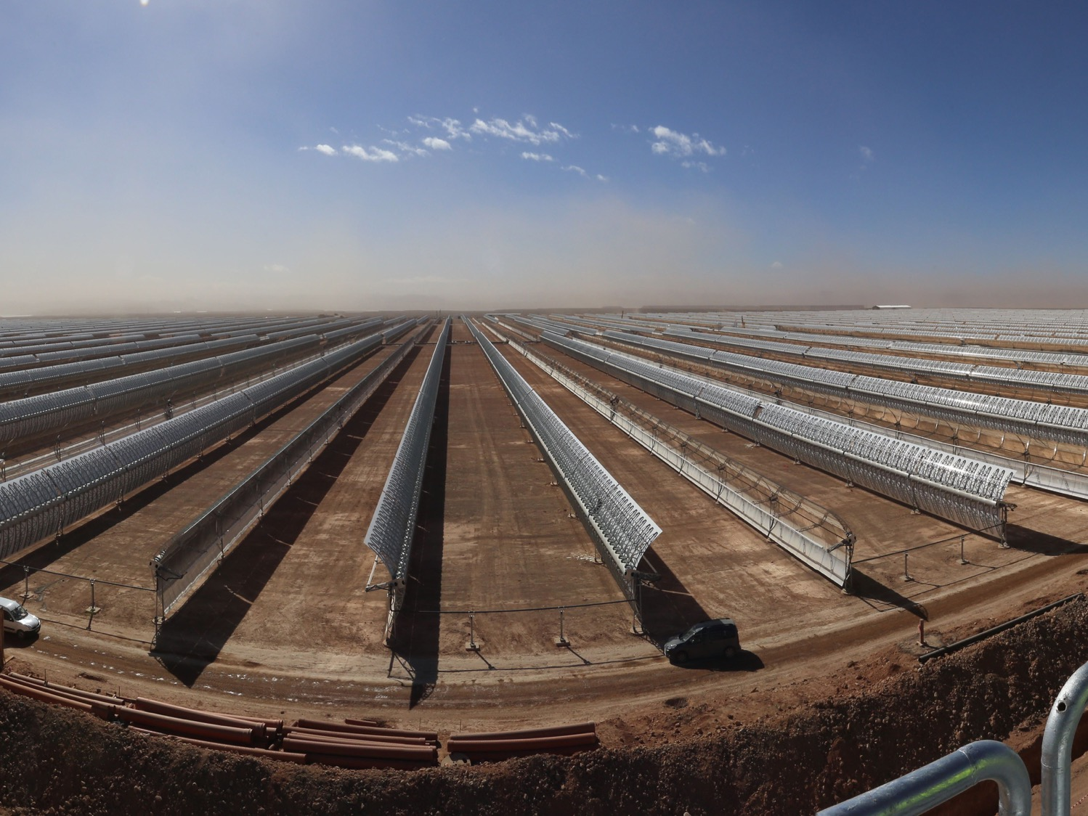
Climate finance pioneer
USD100bn 2016-2020
EUR 16bn for climate in 2018

Slide 5
EIB activities outside the EU
Outside the EU, EIB implements the financial components of agreements concluded under European development aid and cooperation policies
Strong alignment of EIB external activity with EU external policies and actions:
EIB supports investment projects in some 150 non-member countries throughout the world, to support the EU’s external and development policies
The EIB complements the other EU instruments, assistance policies and programmes
EU governance of EIB activities outside the EU:
The EIB’s terms of reference outside the EU are set by multi-annual mandates entrusted to the Bank by the EU Member States and the EP
Broad and high-level objectives set in the ELM (harmonised across regions since 2011)
Regional Technical Operational Guidelines (more detailed guidance in document agreed upon EC and EIB in consultation with EEAS)
Ongoing dialogue at strategic and operational level
EC involved in Decision making (Art. 19)
Close cooperation with the other IFIs active and the EDFIs
European Investment Bank Group
5
Notes:
By clicking on both links are available to the respective sites of the Bank and Fund

Slide 6
Mandates Outside the EU
External Lending Mandate
Pre-Accession
Mediterranean
Neighborhood
East
Asia, Latin America (ALA)
Cotonu Agreement
Africa, Caribbean & Pacific (ACP)
6

Slide 7
Our products
We help catalyse investment
LENDING | BLENDING | ADVISING
Loans But also: Guarantees Micro-finance Equity participation | Combining EIB finance with EU budget (LAIF in Latin America and CIF in the Caribbean) | Prepare, evaluate and support the implementation of projects
Attracting FUNDING for long-term growth

Slide 8
Benefits of an EIB loan
EIB operates on a not-for-profit basis
Benefits of low cost of funding passed on to clients:
Attractive interest rates
Long maturities
Large amounts
Broad range of currencies
Catalyst for participation of other banking or financial partners (EIB finances generally only up to 50% of project costs), including grants
Technical expertise/standards + Technical Assistance (financed under blending)

Slide 9
Lending operations in Latin America
Operations in Latin America started in 1993.
In Latin America, the EIB has, over the years, established a presence that is both material and meaningful for the EU, albeit admittedly limited in size (on average EUR 575 m pa during the last few years).
In Latin America, the Bank has to date supported 117 projects, with a signed total of EUR 8.4bn in 14 countries (with regional credit lines in Central America and the Andean countries enabling the Bank to cover other countries in the region as well).
Framework Agreement is required for EIB to lend in a country.
Close cooperation with the other IFIs and European DFIs active in Latin America
European Investment Bank Group
9
Notes:
By clicking on both links are available to the respective sites of the Bank and Fund

Slide 10
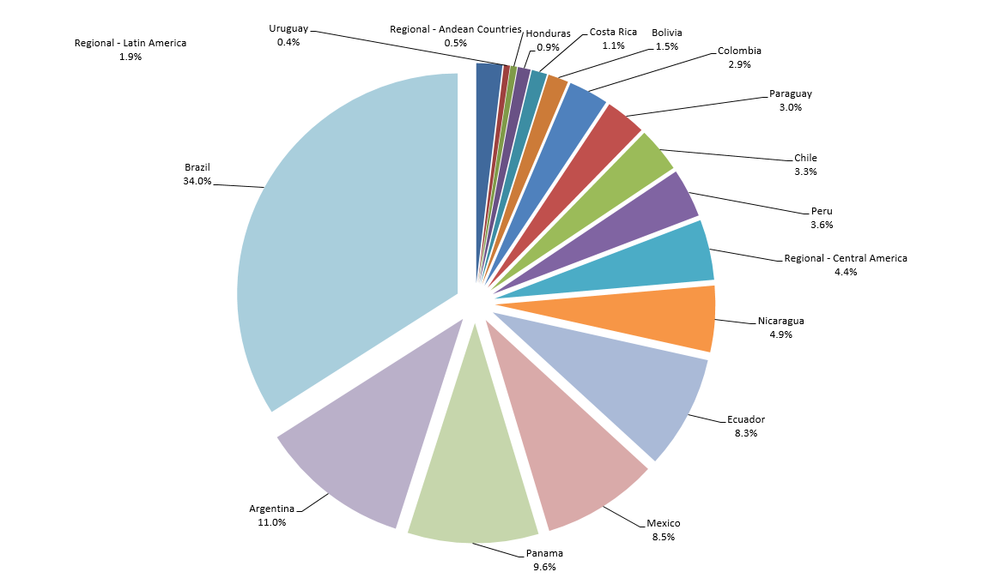
Geographical distribution of EIB lending in
Latin America
European Investment Bank Group
10
Notes:
By clicking on both links are available to the respective sites of the Bank and Fund

Slide 11
Financing in Latin America since 2014
European Investment Bank Group
11
Notes:
By clicking on both links are available to the respective sites of the Bank and Fund

Slide 12
EIB financing in Latin America 2014-2018

Slide 13
Operations in the Caribbean
ACPs: the oldest development cooperation mandate entrusted to the EIB (1963)
Since the 1st operation signed in Trinidad and Tobago in 1978, EIB has achieved a total of EUR 1.8 bn in signatures in the Caribbean region
Total signatures in the Caribbean region under the Cotonou Agreement (i.e., since 2004) amount to EUR 758m in several sectors: 46% in the financial sector, 27% in energy, 15% in transport, 4% water and 3% telecom
Since 2011, 21 transactions have been signed amounting to EUR 416m.
No country or sectors ceilings
No Framework Agreements are required for the EIB to operate in the Caribbean region
European Investment Bank Group
13

Slide 14
Lending in the Caribbean since 2013
Contract Name | Signature Date | Country | M EUR
DR MICROFINANCE FACILITY II D (FDD) | 2013 | Dominican Republic | 1.0
 |  | Total 2013 | 1.0
PORTLAND CARIBBEAN FUND II L P | 2014 | Regional - Caribbean | 23.4
 |  | Total 2014 | 23.4
CARIBBEAN & PACIFIC IMPACT FAC. (ADOPEM) | 2015 | Dominican Republic | 10.0
DR MICROFINANCE FACILITY II E (ADEMI) | 2015 | Dominican Republic | 10.0
TELEM FIBRE TO THE HOME | 2015 | St. Marteen | 8.0
 |  | Total 2015 | 28
CDEEE LOSS REDUCTION PROJECT | 2016 | Dominican Republic | 89.6
DFC MBIL | 2016 | Belize | 8.0
CARIBBEAN AND PACIFIC IMPACT FAC. B (DBJ) | 2016 | Jamaica | 10.0
CARIBBEAN AND PACIFIC IMPACT FAC. C (BANFONDESA) | 2016 | Dominican Republic | 5.0
 |  | Total 2016 | 112.6
CARIBBEAN AND PACIFIC IMPACT FAC. ACME | 2017 | Regional - Caribbean | 3.0
FUNDAPEC | 2017 | Dominican Republic | 5.0
CDB CLIMATE ACTION FL II | 2017 | Regional - Caribbean | 100.0
CDB CLIMATE ACTION FL II - INCREASE POST-HURRICANE | 2017 | Regional - Caribbean | 20.0
 |  | Total 2017 | 128.0
FDI MBIL | 2018 | Haiti | 12.0
CARIBBEAN AND PACIFIC IMPACT FIN FAC E | 2018 | Dominican Republic | 0.7
CARIBBEAN AND PACIFIC IMPACT FIN FAC F (BANFONDE) | 2018 | Dominican Republic | 3.4
CARIBBEAN AND PACIFIC IMPACT FIN FAC F (FONDESA) | 2018 | Dominican Republic | 1.6
 |  | Total 2018 | 17.7
European Investment Bank Group
14
Notes:
By clicking on both links are available to the respective sites of the Bank and Fund

Slide 15
Blending
OVERVIEW:
Blending: combination of budgetary grants with loans from eligible financial institutions, including the EIBto enhance the development impact of investment projects by accelerating investments and Leverage.
In the LAC region, the EIB can mobilize grant resources in particular from the LAIF and CIF, the EU’s regional blending facilities.
EIB is also accredited to mobilize funds from the Green Climate Fund (GCF)
Instruments: Technical Assistance, Investment Grants, and Financial Instruments/Guarantees (risk sharing).
European Investment Bank Group
15

Slide 16
Blending throughout the project cycle: use of TA and IG grants
Technical Assistance grants for:
Project identification and preparation
Capacity building for Promoters and other stakeholders in the project
Project implementation and monitoring
Step 1 Proposal
Step 7
Repayment
Step 2
Appraisal
EIB project cycle
Step 6
Monitoring and reporting
Investment grants for:
Specific components with high social, environmental & economic benefits
Concessionality requirements
Step 3
Approval
Step 5 Disbursement
Step 4 Signature

Slide 17
Blending operations under Latin America Investment Facility (LAIF)
LAIF
supporting sustainable growth in Latin American countries by financing key projects in the areas of energy, agriculture, transport, environment, climate change, SMEs, Information and Communication Technologies and social services.
with a view to improving interconnectivity between and within Latin American countries, increasing environment protection and supporting climate change adaptation and mitigation and promoting equitable and sustainable socio-economic development.
The facility size is of some EUR 350m for the 2014-2020 period.

Slide 18
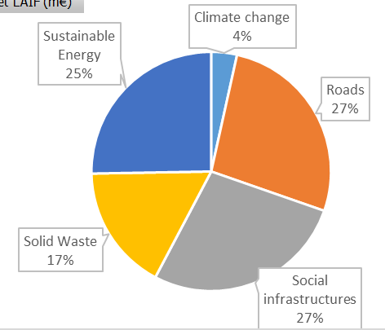
EIB in LAIF
8 projects; EUR68M in LAIF (20%), EUR1600M investment
7 bilateral, 1 regional project in 6 countries
62% Investment grant, 32% TA

Slide 19
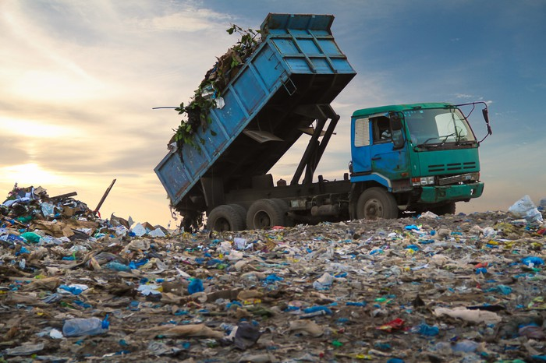
EIB Projects in Latin America
ARGENTINA: Integrated Waste Management Programme in Jujuy
EIB Loan: USD 45m, Signature: 23.03.2018
The project concerns the implementation of an integrated waste management system for the collection, treatment and safe disposal of municipal solid waste.
Benefits/SDG:
The project is designed to process 200,000 tons of waste per year, and will have significant health and environmental benefits for some 800,000 citizens in the province.
The project is expected to contribute to achieving several Sustainable Development Goals, in particular Good Health and well-being (SDG 3), Sustainable cities and communities (SDG11), and Climate Action (SDG13).
LAIF support:
Investment Grant (EUR 8m) and TA (EUR 3m) to provide technical assistance to the project promoter during the preparation and execution of the programme and reduce the budgetary cost of the investments.
Total budget: USD 120m
LAIF: EUR 11m
EIB: USD 45m
Co-financiers:
IADB: USD 14m
Own Resources: USD 51m
19
Notes:
19

Slide 20
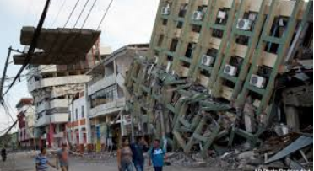
EIB Projects in Latin America
ECUADOR: Post-Earthquake Reconstruction Framework Loan
EIB Loan: USD 175m, Signature: 14.11.2016
The multi-sector framework loan supports the integrated rehabilitation and reconstruction of the province of Manabi, particularly on the sub-region of Portoviejo, which is one of the regions most affected by the recent earthquake.
The reconstruction will follow an integrated territorial approach aiming at restoring, and where possible improving, the population’s living conditions
Benefit/SDG: reestablishment of basic public services and of livelihoods, support to regional GDP growth; and political stability, governance standards and social cohesion
LAIF support:
Technical Assistance Grant ensures efficient project implementation and will help the different entities to cope with the exceptional circumstances.
Total budget: USD 180m
LAIF: EUR 7m
Lead FI: USD 175m
20
Notes:
20
Paraguay, with a population of about seven million people and a surface area
of 406,752 square kilometres, has adequate electricity generation capacity.
Virtually all generation is hydroelectric. One of the main challenges that
the country is facing is the transmission of electricity from the generation
plants to the areas of consumption, particularly the capital, Asunción, which
accounts for about 57% of the total national demand. Transmission capacity
is undermined by frequent systems overloads, disruptions and a high level
of power losses, while demand has increased more than 8% in the past ten
years.
The project aims to improve the competitiveness of Paraguay’s productive
sector by providing reliable and adequate power, strengthen supply and access
for residential customers, particularly the poorest, and offer surplus
clean electricity from renewable sources to neighbouring Argentina and Brazil,
which rely mainly on fossil-fuel generation.
The project has two main components. The first is the construction of a 300-
km 500kV high-voltage transmission line linking the Yacyretá hydropower
plant and Asunción. The second is an energy loss-reduction programme that
comprises of the roll-out of 625,000 electronic meters which will contribute
to reducing power losses from the present level of 30% to 24% by 2020. Of
these meters, 275,000 will be provided by the project promoter, the stateowned
utility Administración Nacional de Electricidad (ANDE), while LAIF will
finance the acquisition of the other 350,000 meters. ANDE will provide own
resources to cover the equipment and installation costs (cables, derivation
boxes, installation material) and related services.
The meters funded by LAIF will serve different purposes. 50,000 meters will
be installed in informal settlements. Another 230,000 meters are destined
for families who benefit from a cut-price social tariff for electricity. The re-
In 2013-2014, seven projects were approved for a total LAIF contribution of
€43 million.
maining 70,000 meters are for residential clients
with low energy consumption. Informal settlements
and subsidised clients are traditionally not
a priority for utilities as the connection costs are
high and the benefits in terms of additional income
are low.
The 350,000 electronic meters funded by LAIF
will contribute to the reduction of power losses.
ANDE’s own loss-reduction efforts linked to the
installation of its 275,000 meters will centre on
commercial, industrial, other private and public
sector clients as well as mainstream residential
consumers.
The installation of the new high-voltage line and
the provision of new meters will enable ANDE
to manage its network more efficiently for its
benefit and for the benefit of its customers.
Removing bottlenecks between Yacyretá and
Asunción will enable Paraguay to offer more of its
surplus “green” electricity to Argentina and Brazil.
At the same time, by providing meters and connections
to informal settlements, social-tariff and
low-income residential customers, the promoter
will provide affordable and reliable electricity to
350,000 domestic clients.
Value added of EU grant
Whole project:
Economic rate of return of the whole project has been evaluated at 17% by EIB.
Financial rate of return of the whole project is evaluated by the promoter to be 6%. EIB estimates if full optimization benefits of Itaipú were factored in, this could raise up to 28%
Component financed by LAIF:
Regarding the loss reduction component and energy access in informal settlements, social tariff customers and residential customers with low consumption (350,000 meters) to be financed by LAIF and the promoter:
Costs: An estimation of costs for installation and other equipment has been considered and will be financed by the promoter.
Benefits: Additional energy billed has been considered as benefits.
Results (including LAIF grant contribution):
Results from EIB calculations are an estimated ERR of 38% and an IRR of 4%.
Sensibility analysis indicates that if some meters don´t reach estimated duration of 20y, IRR would be below 0.

Slide 21
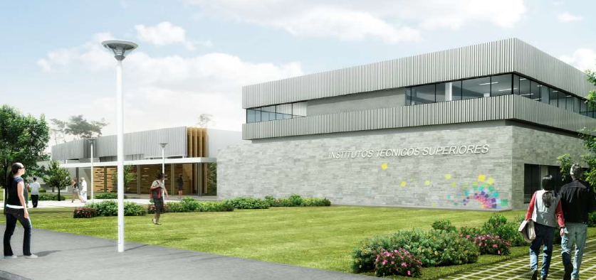
EIB Projects in Latin America
ECUADOR: Technical and Technological Institutes Programme
EIB Loan: EUR 70m, Signature: 28.12.2016
The project concerns the new construction, extension, rehabilitation and equipment of 21 Technical and Technological Institutes (TTIs), classified at the post-secondary level of education.
The project will allow the country to consolidate and modernise the provision of vocational education and training.
Benefit/SDG: Quality education.
LAIF support:
The LAIF Investment Grant supports the construction of one Institute in Portoviejo, one of the cities most affected by the earthquake in April 2016
Total budget: EUR 191m
LAIF: EUR 11m
Lead FI: EUR 70m
Co-financiers: World Bank
Other: USD 90m
21
Notes:
21
Paraguay, with a population of about seven million people and a surface area
of 406,752 square kilometres, has adequate electricity generation capacity.
Virtually all generation is hydroelectric. One of the main challenges that
the country is facing is the transmission of electricity from the generation
plants to the areas of consumption, particularly the capital, Asunción, which
accounts for about 57% of the total national demand. Transmission capacity
is undermined by frequent systems overloads, disruptions and a high level
of power losses, while demand has increased more than 8% in the past ten
years.
The project aims to improve the competitiveness of Paraguay’s productive
sector by providing reliable and adequate power, strengthen supply and access
for residential customers, particularly the poorest, and offer surplus
clean electricity from renewable sources to neighbouring Argentina and Brazil,
which rely mainly on fossil-fuel generation.
The project has two main components. The first is the construction of a 300-
km 500kV high-voltage transmission line linking the Yacyretá hydropower
plant and Asunción. The second is an energy loss-reduction programme that
comprises of the roll-out of 625,000 electronic meters which will contribute
to reducing power losses from the present level of 30% to 24% by 2020. Of
these meters, 275,000 will be provided by the project promoter, the stateowned
utility Administración Nacional de Electricidad (ANDE), while LAIF will
finance the acquisition of the other 350,000 meters. ANDE will provide own
resources to cover the equipment and installation costs (cables, derivation
boxes, installation material) and related services.
The meters funded by LAIF will serve different purposes. 50,000 meters will
be installed in informal settlements. Another 230,000 meters are destined
for families who benefit from a cut-price social tariff for electricity. The re-
In 2013-2014, seven projects were approved for a total LAIF contribution of
€43 million.
maining 70,000 meters are for residential clients
with low energy consumption. Informal settlements
and subsidised clients are traditionally not
a priority for utilities as the connection costs are
high and the benefits in terms of additional income
are low.
The 350,000 electronic meters funded by LAIF
will contribute to the reduction of power losses.
ANDE’s own loss-reduction efforts linked to the
installation of its 275,000 meters will centre on
commercial, industrial, other private and public
sector clients as well as mainstream residential
consumers.
The installation of the new high-voltage line and
the provision of new meters will enable ANDE
to manage its network more efficiently for its
benefit and for the benefit of its customers.
Removing bottlenecks between Yacyretá and
Asunción will enable Paraguay to offer more of its
surplus “green” electricity to Argentina and Brazil.
At the same time, by providing meters and connections
to informal settlements, social-tariff and
low-income residential customers, the promoter
will provide affordable and reliable electricity to
350,000 domestic clients.
Value added of EU grant
Whole project:
Economic rate of return of the whole project has been evaluated at 17% by EIB.
Financial rate of return of the whole project is evaluated by the promoter to be 6%. EIB estimates if full optimization benefits of Itaipú were factored in, this could raise up to 28%
Component financed by LAIF:
Regarding the loss reduction component and energy access in informal settlements, social tariff customers and residential customers with low consumption (350,000 meters) to be financed by LAIF and the promoter:
Costs: An estimation of costs for installation and other equipment has been considered and will be financed by the promoter.
Benefits: Additional energy billed has been considered as benefits.
Results (including LAIF grant contribution):
Results from EIB calculations are an estimated ERR of 38% and an IRR of 4%.
Sensibility analysis indicates that if some meters don´t reach estimated duration of 20y, IRR would be below 0.

Slide 22
EIB Projects in Latin America
REGIONAL: Fonplata Regional Framework Loan
EIB Loan: USD 60m
The Framework Loan aims at supporting multi-sector projects targeting extreme poverty and climate change resilience in the sub-region eligible for Fonplata financing, which comprises the River Plata Basin (i.e. part of Argentina, Bolivia, Brazil, Paraguay and Uruguay).
LAIF support:
Technical Assistance Grant (EUR 3 m) to enhance Fonplata’s due diligence capacity in the field of Climate Action
Total budget: USD 121m
EIB: USD 60m
Co-financiers:
Other: USD 61m
22
Notes:
22

Slide 23
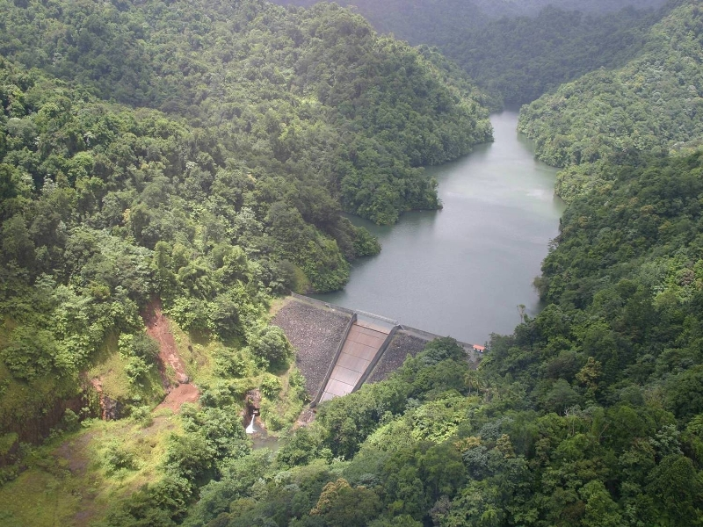
EIB Projects in the Caribbean
Regional: CDB Climate Action Line of Credit
EIB Loans:
EUR 50m, Signature: 29.12.2011
EUR 100m, Signature: 24.05.2017
EUR 20m, Signature: 13.11.2017
The project aims at providing funding for small-scale climate change mitigation and adaptation projects in the public and private sectors, across the Caribbean, including a dedicated window for post-hurricane infrastructure reconstruction.
Technical assistance program (EUR 4m) to support capacity building and improve project preparation, and interest rate subsidy – ACP Investment Facility subsidy envelope.
SDG13 Climate Action.
John Compton dam on St. Lucia island
Total budget: EUR 350m
EIB: EUR 170m
Co-financiers:
CDB/Caribbean Governments: EUR 180m
23
Notes:
23

Slide 24
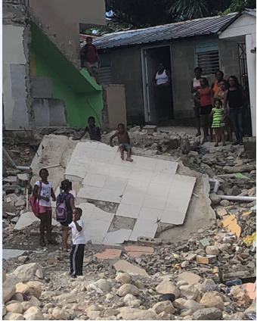
Pipeline in the Caribbean
Dominican Republic: POST-DISASTER AND CLIMATE CHANGE FL
EIB Loans:
USD 50m, Signature: aimed for Q1 2018
Multi-sector framework loan to finance the reconstruction of infrastructure damaged by natural disasters and increase resilience to climate change in the Dominican Republic
Loan blended with EUR 17m grant for EU-CIF mobilized by the EIB
Substantial interest rate subsidy – ACP
The loan will contribute directly to:
SDGs 1 (No poverty), 9 (Industry, innovation and infrastructure), 11 (Sustainable cities and communities) and 13 (Climate Action) and indirectly to SDGs 8 (Decent work and economic growth) and 10 (Reduced inequalities)
Livelihoods impacted by Hurricane Matthew in the Dominican Republic
Total budget: USD 70m
EIB: USD 50m
Co-financiers:
CIF-EU: EUR 17m
24
Notes:
24

Slide 25
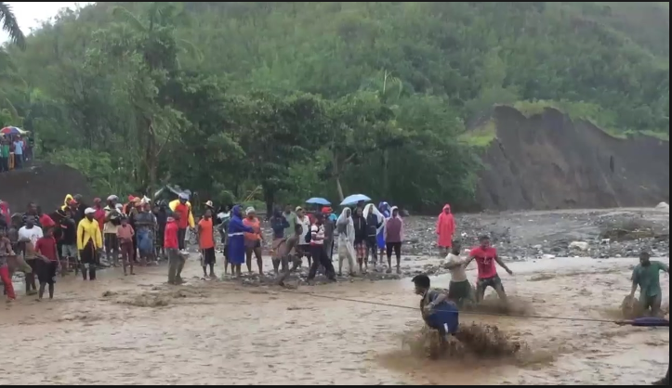
Pipeline in the Caribbean
Haiti: CLIMATE RESILIENT BRIDGES
EIB Loans:
EUR 25m, Signature: aimed for Q2 2018
Framework loan to finance the climate-change resilient reconstruction of bridges and related infrastructure damaged by hurricanes and floods in Haiti
Loan blended with EUR 20m grant for EU-CIF to be mobilized by the IADB
Substantial interest rate subsidy – ACP Investment Facility subsidy envelope.
The loan will contribute directly to:
SDGs 1 (No poverty), 9 (Industry, innovation and infrastructure), 11 (Sustainable cities and communities) and 13 (Climate Action) and indirectly to SDGs 8 (Decent work and economic growth) and 10 (Reduced inequalities)
Vital Haitian bridge collapses during hurricane Matthew
Total budget: USD 270m
EIB: EUR 25m
Co-financiers:
IADB: USD 240m
25
Notes:
25

Slide 26
Concluding remarks
EIB is committed to enhance its support to EU policies and, to that effect, adapts its origination to ensure appropriate geographical and sectoral targeting in line with EU priorities.
EIB will continue to cooperate closely with the EC, EEAS, and with the other IFI, EDFIs, and the region’s Development Banks.
EIB is exploring new avenues to enhance our support to investment in LAC, to achieve higher IMPACT.
Blending will remain an important component of the EIB instruments to support sustainable development in Latin America and the Caribbean.

