Slide 1


UNEP Finance Initiative
Use different logo for the best visibility.
Align right side of logo to right sides of white lines below
Responsible banking….
from disclosure to impact and alignment
Eric Usher/ 21 May 2019 / Madrid, ALIDE
Photo credit to be given
as shown alongside
(in black or in white)
© UN Photo/Sylvain Liechti
Notes:
This work has two fundamental sides or prongs. Or perhaps objectives.
Resilient financial institutions – resilient financial system.
On the one hand it aims to help FIs understand, assess, and react to the new realities of climate change – physical (meteorological,. hydrological), technological, and political. In other words, it aims FIs understand, assess and react to the risks and opportunities that climate change throws at them.
Proactive financial institutions – proactive financial systems that drive, enable and catalyse the economic transitions that we need, be it towards getting rid of greenhouse gas emissions or towards adapting societies to physical climate change.
On the other hand our work aims to help FIs and Governments understand how private finance – at the right scale and pace – can be mobilized to enable economic decarbonisation and climate-resilience. Rather than reacting to new realities this work understands the role of the finance sector as one of pro-actively financing, and as such enabling or catalysing, the climate economic transition towards decarbonization and climate-resilience.
We do that typically via peer-to-peer type platforms and leadership groups of Fis.

Slide 2

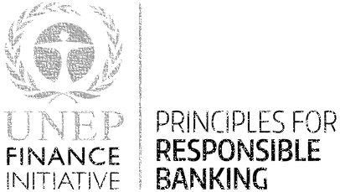

Responsible / Sustainable Finance Frameworks
An investor initiative in partnership with UNEP Finance Initiative and UN Global Compact
Notes:
Species loss: 40% of Amphibians; 33% of marine mammals and 33% of reef-forming corals are now at risk. IPBES report
IPCC: CO2 is now 415ppm, up 50% from before industrialization.

Slide 3

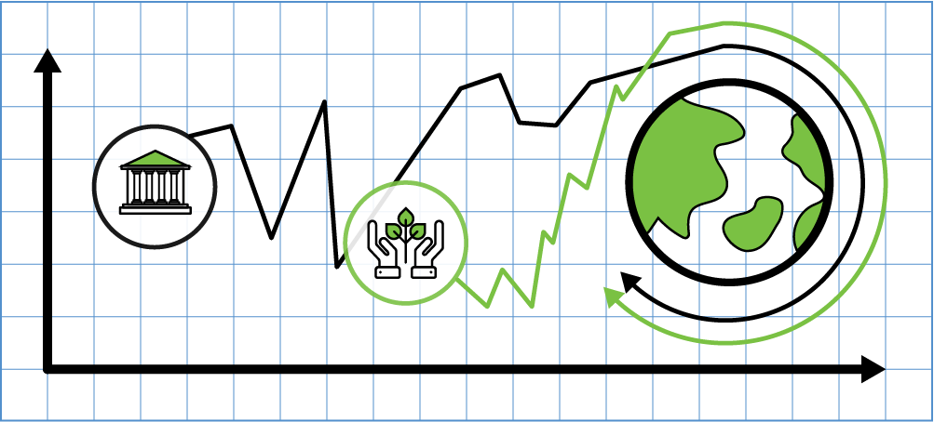
Banking sector at the service of
people and planet
Disclose
Impact
Align

Slide 4

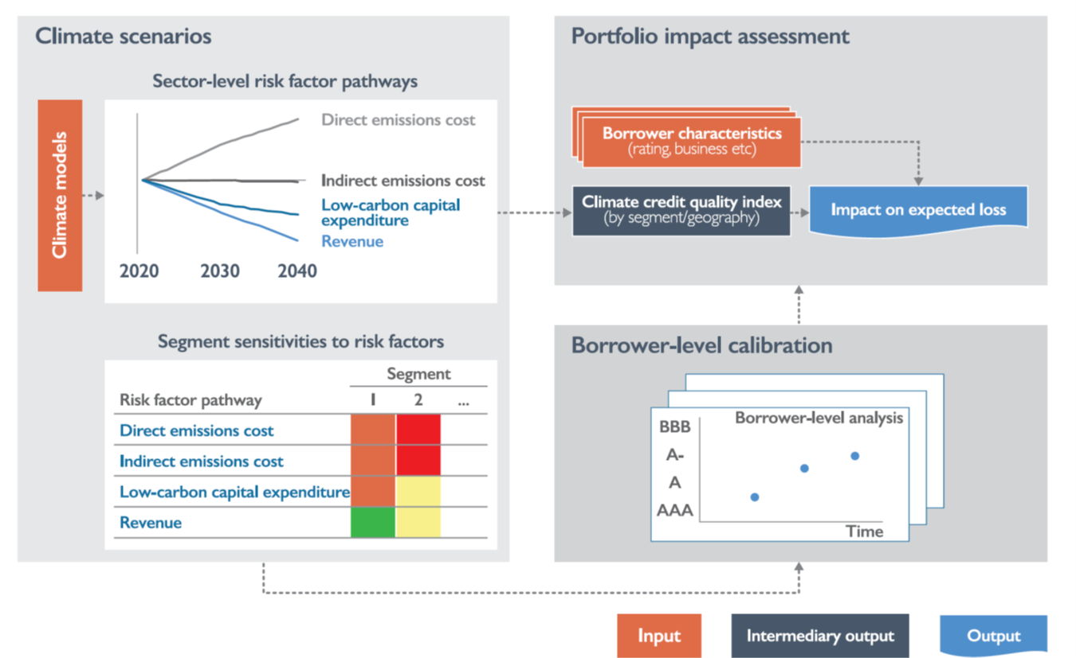
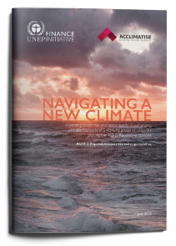
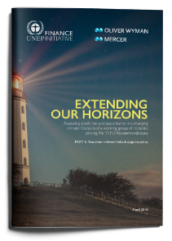
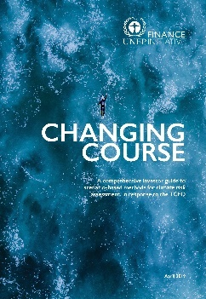
Disclose: climate risks in loan-books
Climate Transition Risk Scenario Models
Notes:
◼◼ Transition scenario models: A wide range of energy system, economic, and integrated
models, which this report refers to in aggregate as transition scenario models, provide
relevant scenarios for analysis. These models are capable of producing an internally
consistent picture of how transition risk could evolve over time and across sectors and
geographies, and they can generate relevant macro-economic metrics for risk analysis.
They have been used in studies ranging from the Intergovernmental Panel on Climate
Change (IPCC) assessment reports to sector-specific analyses of climate change impacts.
Despite these benefits, transition scenario models face significant limitations in corporate
risk analysis. Models often employ aggregated and high-level representations of
energy-economy interactions, lacking specific quantification of scenario impacts at a
company or industry level. Additionally, transition scenario models are oriented toward
use in macro-economic and policy assessment environments, requiring additional interpretation
for financial analysis.
◼◼ Credit and sustainability experts within banks are able to identify the link between
scenarios and the creditworthiness of the borrowers. Using experts for bottom-up
assessment has significant precedent in risk management. Banks’ borrower risk assessments
are institution-specific processes that drive the competitiveness of their businesses.
Analogous exercises, such as regulation-driven macro-economic stress-testing,
also embed institution-specific risk assessments that reflect expert input.
Expert judgment alone, however, risks yielding inconsistent results. Experts could identify
a variety of futures, and a wide range of methods, to assess risk at a borrower-level,
making judgments difficult to compare across sectors and institutions. Furthermore,
such an assessment on its own is unlikely to be scalable at an institutional level. The
workload created by a borrower-by-borrower assessment of impacts could quickly overwhelm
experts when applied to the whole of a portfolio.
◼◼ Finally, a variety of well-established techniques for credit risk modelling can help
establish the link between scenarios and credit risk. In the past decades, bank risk
management functions have expanded dramatically, creating methodologies, tools, and
frameworks to assess and manage various institutional risks. In particular, since the
financial crisis, regulators around the world have pushed for banks to develop advanced
stress testing infrastructure to ensure they can sustain systemic, macro-economic shocks
as well as idiosyncratic shocks. While there are differences, these stress testing exercises
are similar to scenario analysis in that both exercises consider the impact to the bank of
a hypothetical scenario unfolding over time (see Box 1 for more detail on the differences
between macro-economic and climate scenario analysis).
Applying these techniques to transition risk, however, demands additional effort. These
frameworks will require new data sources and a modified conceptual

Slide 5
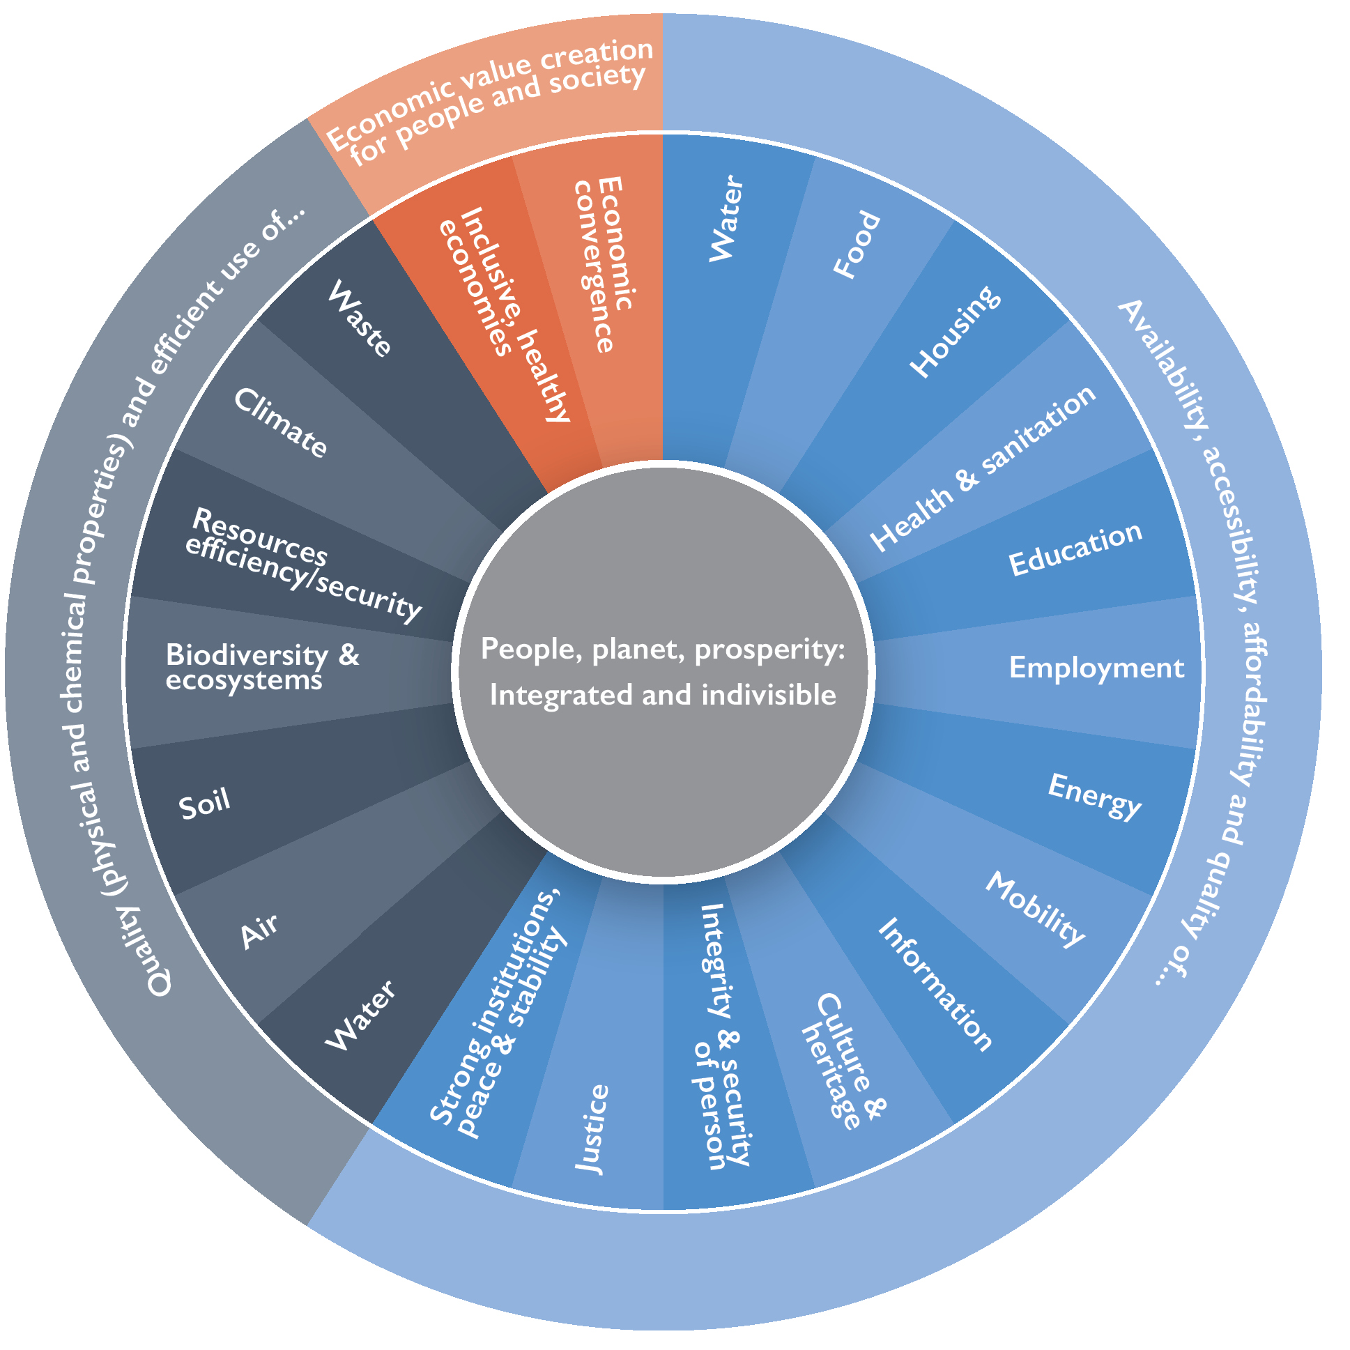
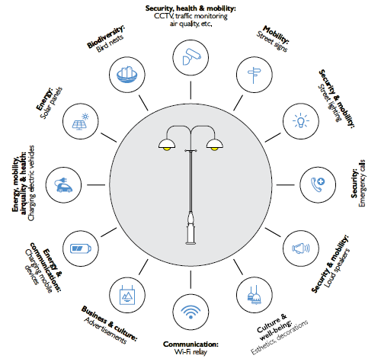
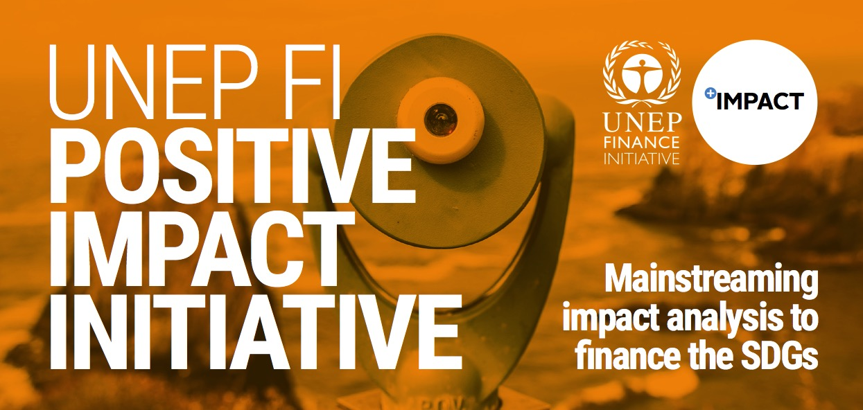
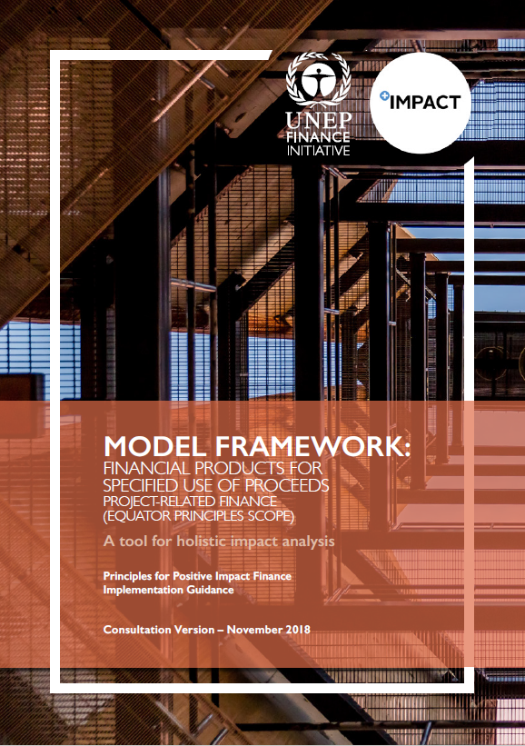
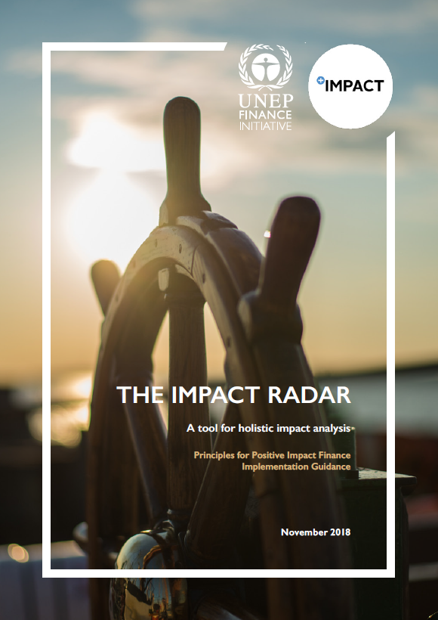
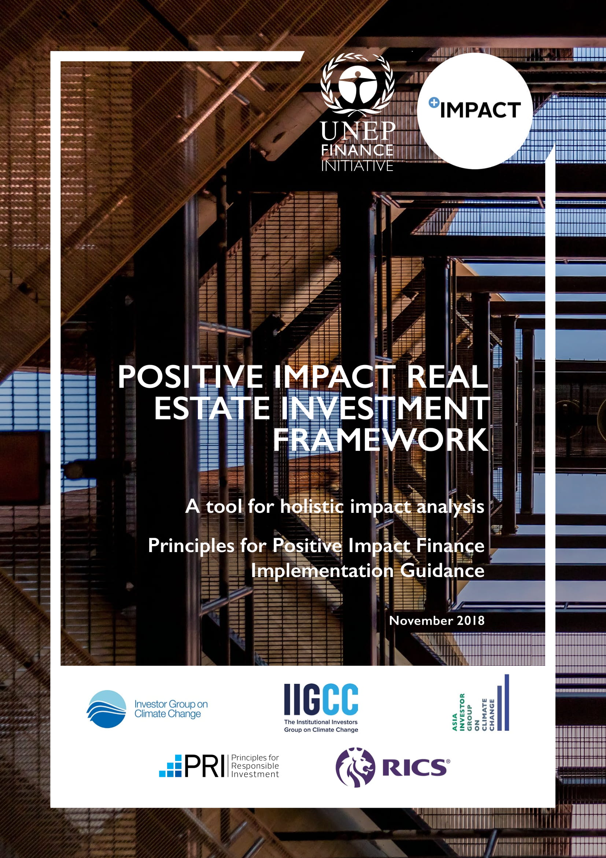
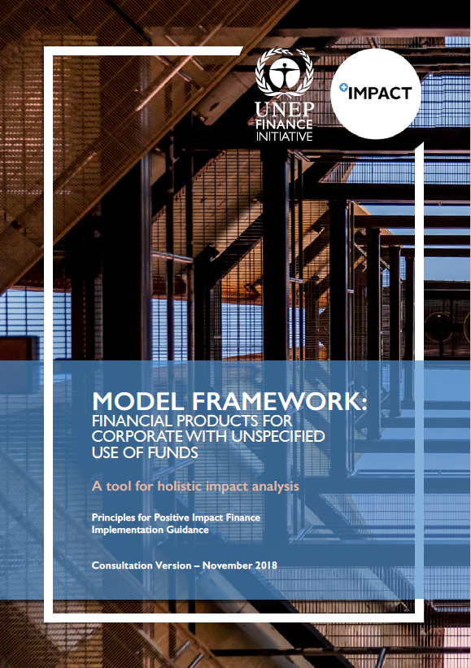
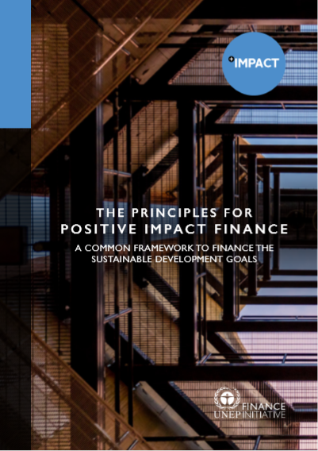
Impact Radar

Slide 6
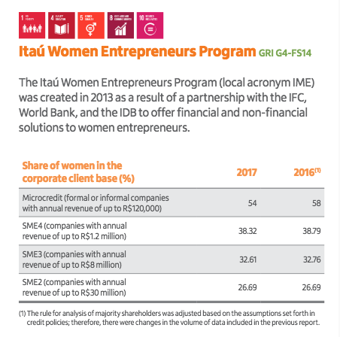

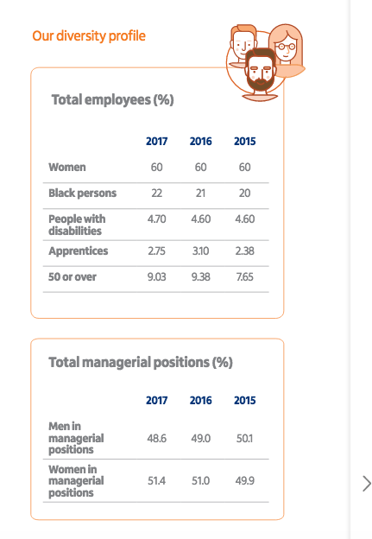
Impact Examples
Banco Itau

Slide 7
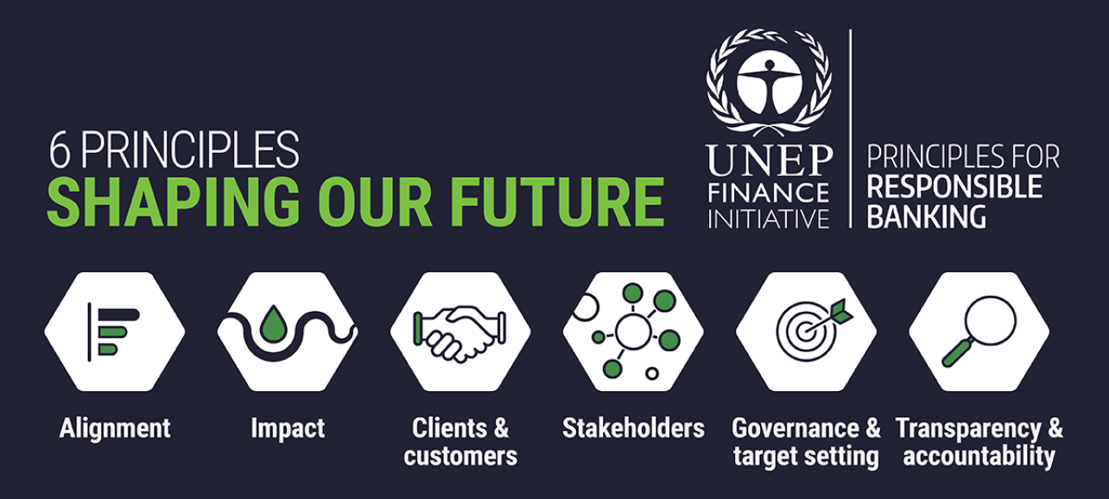

Align
1. Identify Impacts
2. Prioritise Impacts
3. Set/Disclose Targets
4. Report Progress

Slide 8



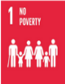
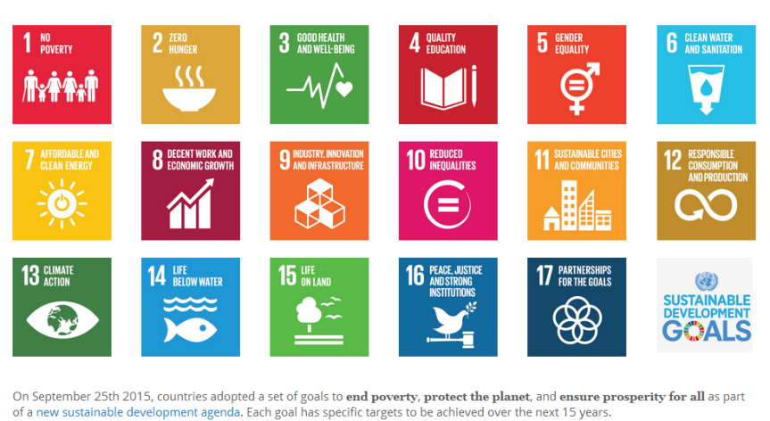



Target Setting Example
BBVA: €100 Billion mobilization between 2018 and 2025
To finance
To manage
To engage
Transition to a low carbon economy
Financial inclusion &
entrepreneurship
Lending to underserved
Lending to vulnerable microentrepreneurs
Lending to women entrepreneurs
New digital business
Impact investment
Green lending to companies & institutions
Green bonds intermediated as bookrunner
Energy efficiency, water & waste management & solutions for SMEs & individuals
Green investment funds & equity
€ 70 BILLION
€ 18
BILLION
€ 12
BILLION
Infrastructures & agribusiness
Project & corporate lending in education, health & affordable housing
Social bonds intermediated as bookrunner
Social investment funds & equity
Agribusiness lending under sustainability criteria

Slide 9
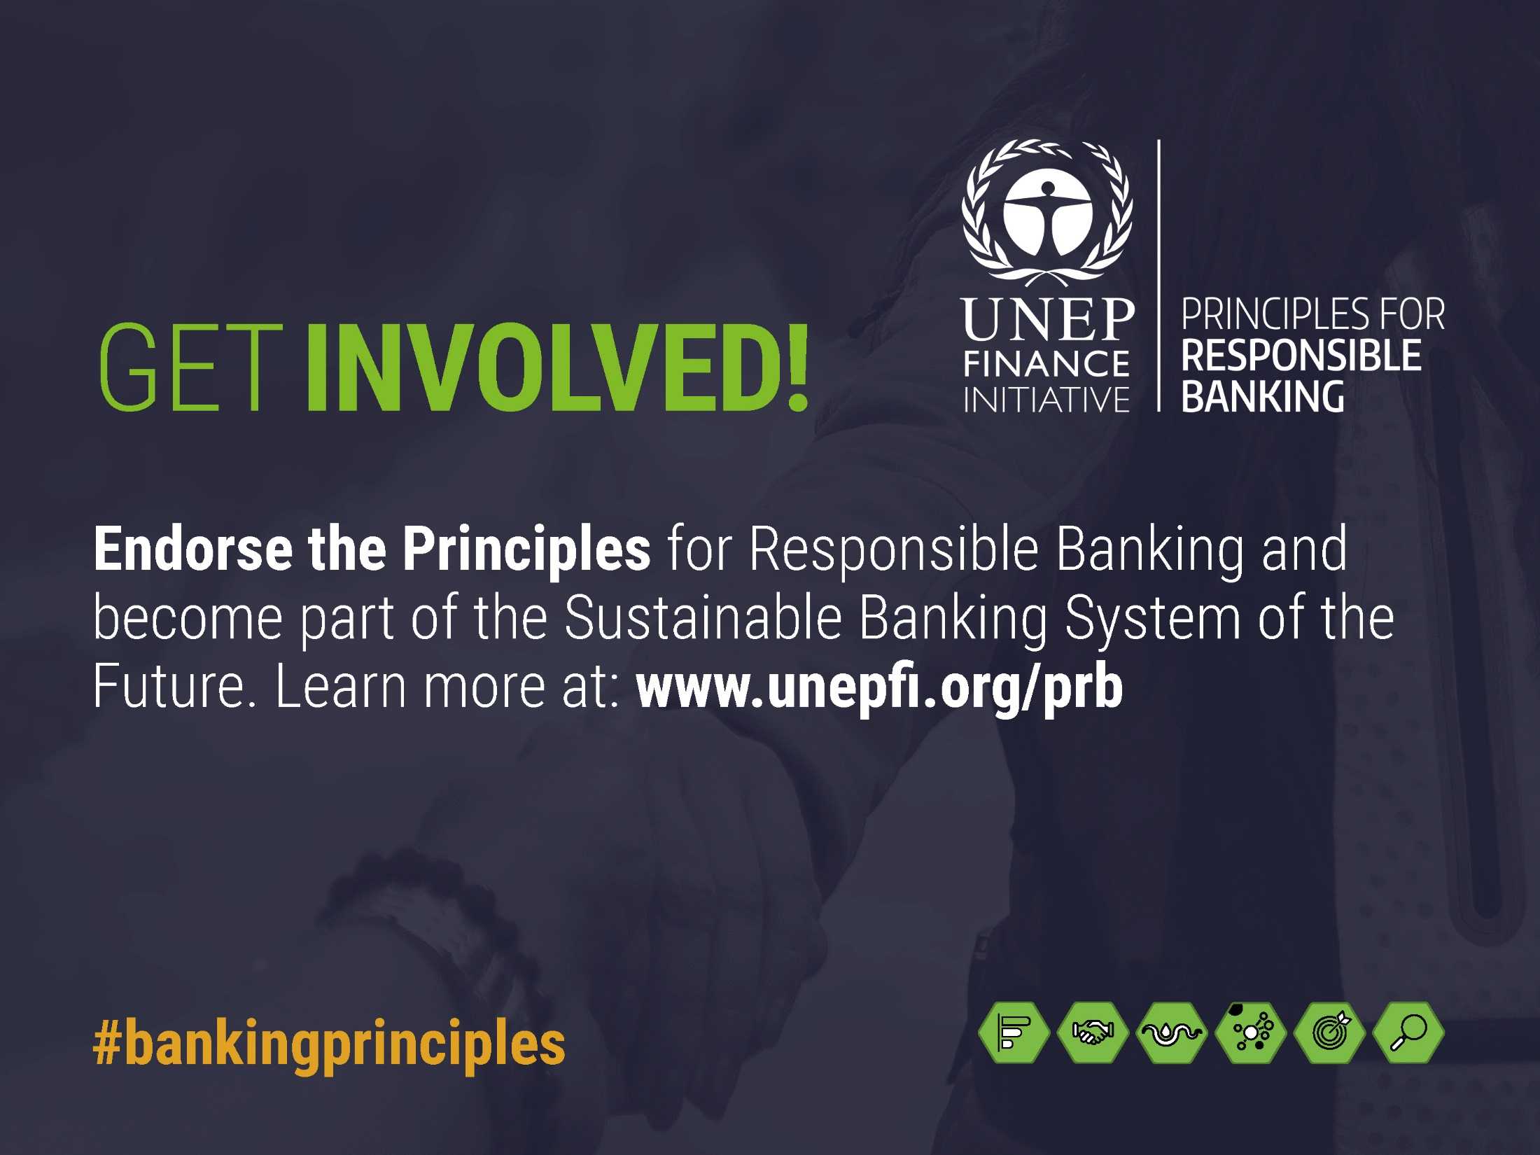
Become a Founding Signatory on 22nd September 2019!

