Slide 1
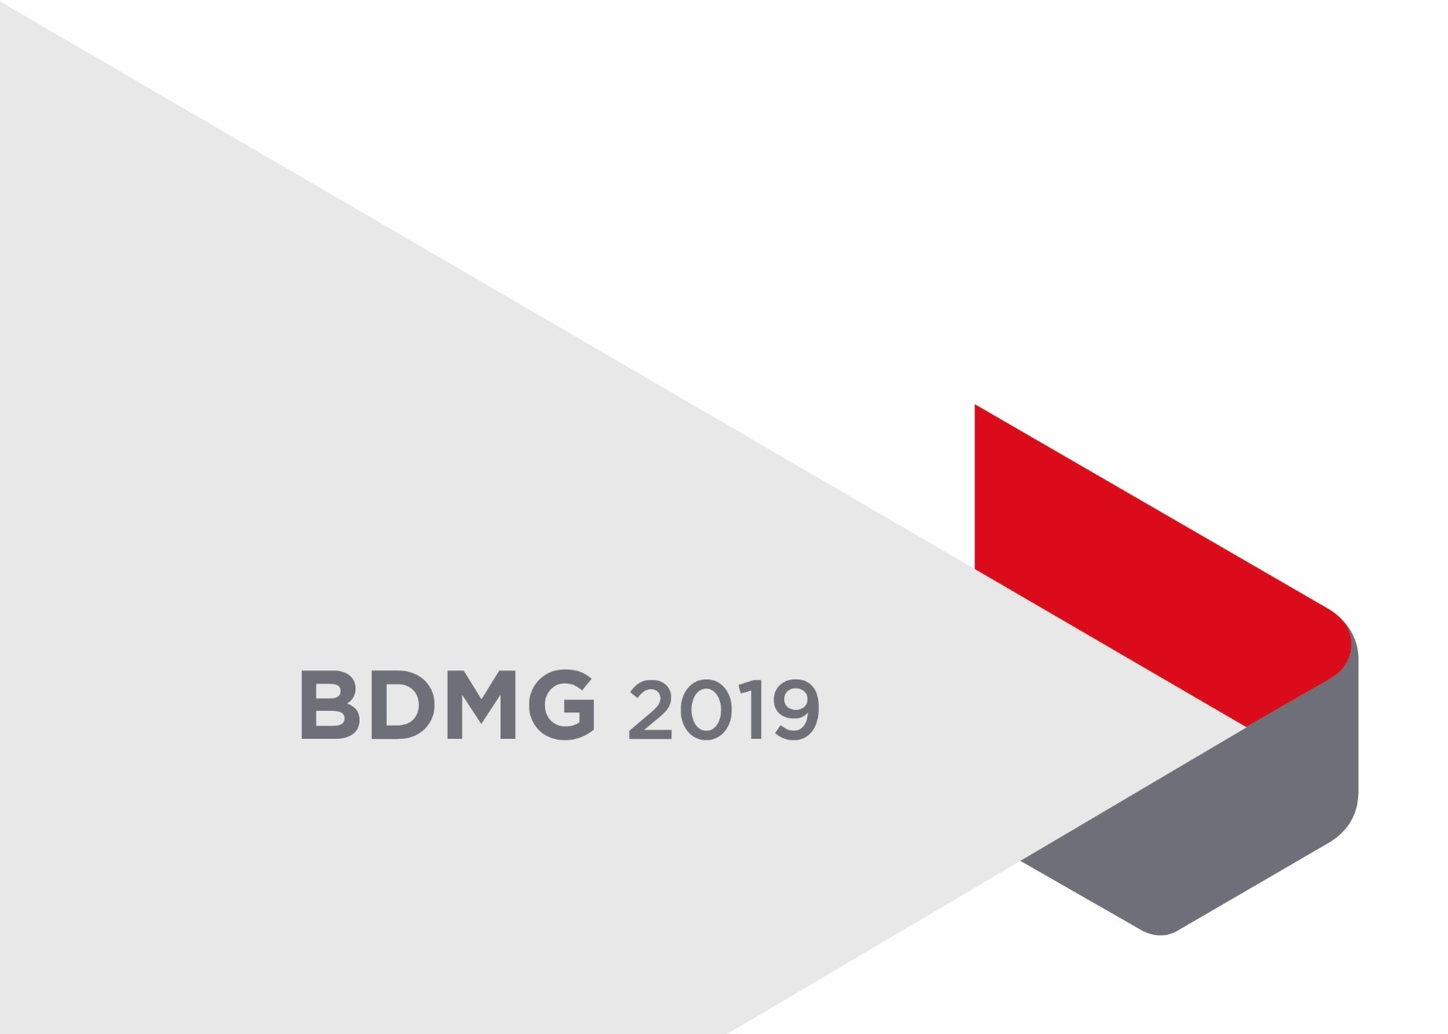
BDMG
Use of non-financial instruments
Panel: The challenges of financing productivity and competitiveness in Latin America and the role of development
MAY 21, 2019

Slide 2
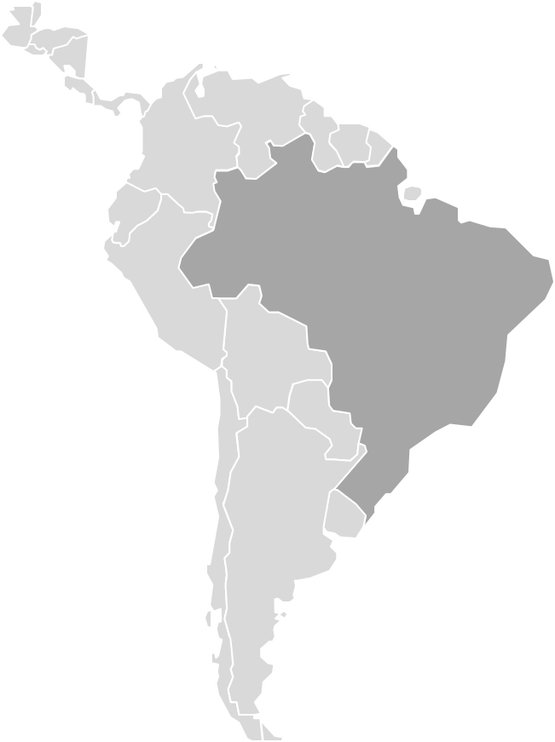
Banco de Desenvolvimento de Minas Gerais (BDMG) is a state controlled company whose mission is to promote economic and social development in the State of Minas Gerais
Minas Gerais
21 MILLION INHABITANTS [2018] Similar to Australia
2nd most populous state of Brazil
3rd BIGGEST GDP
between Brazilian states: USD 149.62 billion* [2018]
2nd LARGEST INDUSTRY 11.6% of Brazilian industry

Slide 3
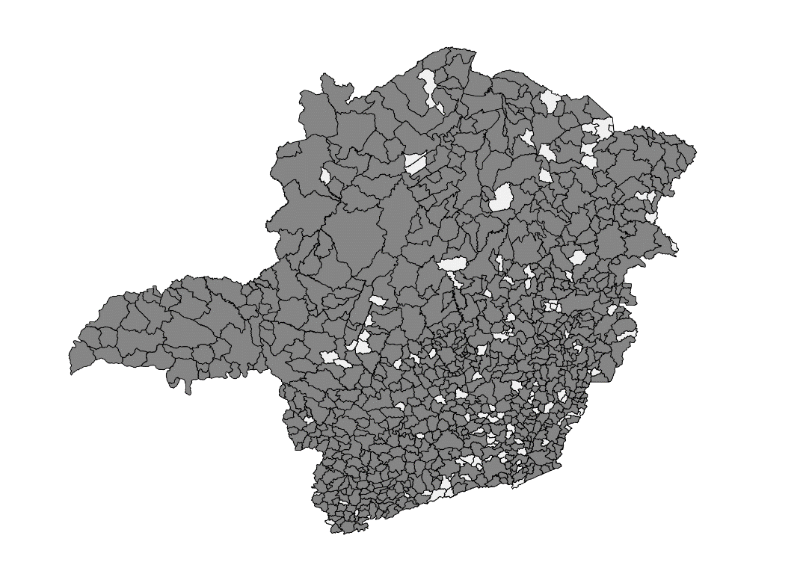
OVERVIEW
PORTFOLIO & IMPACT
BRL 6.0 Bi
Portfolio
1Q 2019
BRL 1.47 Bi
Average disbursement in the past 4 years
Presence in the State of Minas Gerais (745 municipalities with at least 1 client)
87%
BRL 1,4 Bi
disbursement in the last 12 months [1Q 2018-1Q 2019] meant*:
26,530 jobs created
BRL 1,14 bilion in impact on production
BRL 53.2 million in ICMS (tax over the circulation of goods and services) return
Portfolio 1Q 2019
*Estimated values, obtained with the methodology of the input-output matrix, referring to 1Q 2019

Slide 4
OVERVIEW
SOURCE OF RESOURCES
More than
BRL 1.9 billion
international and national funding for different purposes since 2012
1st Brazilian regional development bank
to raise funds in global Market
USD 200 million
EUR 31 million
BRL 1.2 billion domestic bonds
Onlendings diversification
FUNCAFÉ

Slide 5
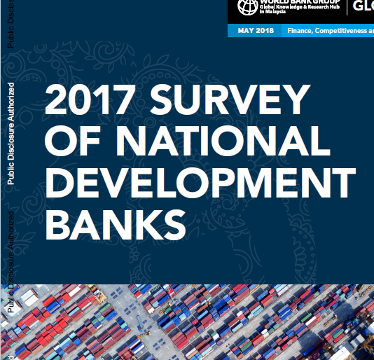
CONTEXT
NON-FINANCIAL INSTRUMENTS
The landscape of Development Banks is shifting:
According to 2017 National Development Survey:
55%
offer consulting and training
41%
offer other types of advisory and technical assistance, activities and networking and business matching
Offer advisory services and product combinations
Instead of focusing on postwar economy-rebuilding, new areas of focus: supporting environmental protection, use of renewable energy, SMEs and fostering innovation
The value added is shifting from simply providing funds to providing counsel on best possible use of these funds
Importance of bringing value added to the client and offering more than simple lending products
31%
is the average revenue share not originating from credit operations*
Pursue activities to diversify and increase their revenues together with the social, economic political effects
Some DBs also help in structuring complex deals, creating new channels to mobilize private funds, providing technical assistance, creating and disseminating knowledge and building know-how
Sources: Roland Berger Report, Survey of National Development Banks (World Bank Group)

Slide 6
CONTEXT
NON-FINANCIAL ADDITIONALITY
ADVISORY SERVICES
RISK MITIGATION
KNOWLEDGE, INNOVATION, AND CAPACITY BUILDING
Maximize existing knowledge inside the bank (minimum marginal costs)
Client assistance to make their businesses sustainable
Help companies in structuring specific projects
Mitigation of risks, such as regulatory, project, economic cycle, or political risks
Expertise, innovation, knowledge and/or capabilities that are material to a timely impact
Capacity-building support may be provided either in-house or by external experts
STANDARD- SETTING: helping projects and clients achieve higher standards
PLATFORMS AND NETWORK MANAGEMENT
Promote improved policies and provide expertise in environmental, social, and governance standards (ESG) and on integrity and procurement best practice
Support to clients to improve impact and performance of the project
ECONOMIC ANALYSIS
Gathering and evaluation of information (data, policies and statistics) about the economy, governments institutions or social services systems
Enable networking between companies of different sizes
Facilitate joint business development, create cooperation opportunities and leverage synergy between innovative companies

Slide 7
STRATEGY
BDMG’S NON-FINANCIAL INSTRUMENTS
[CURRENT INITIATIVES]
MICRO & SMALL BUSINESS
INNOVATION HUB
MUNICIPALITIES
Creates opportunities and leverages synergy between innovative companies
Structuring and approving infrastructure municipalities projects
Online credit for Micro and Small businesses with financial education opportunity
PUBLIC SECTOR ADVISORY
PARTNERSHIP FOR STRUCTURING FINANCIAL SOLUTIONS
Technical, legal, economic and financial modeling in concessions and PPPs for major projects
Partnership with Renova Foundation

Slide 8
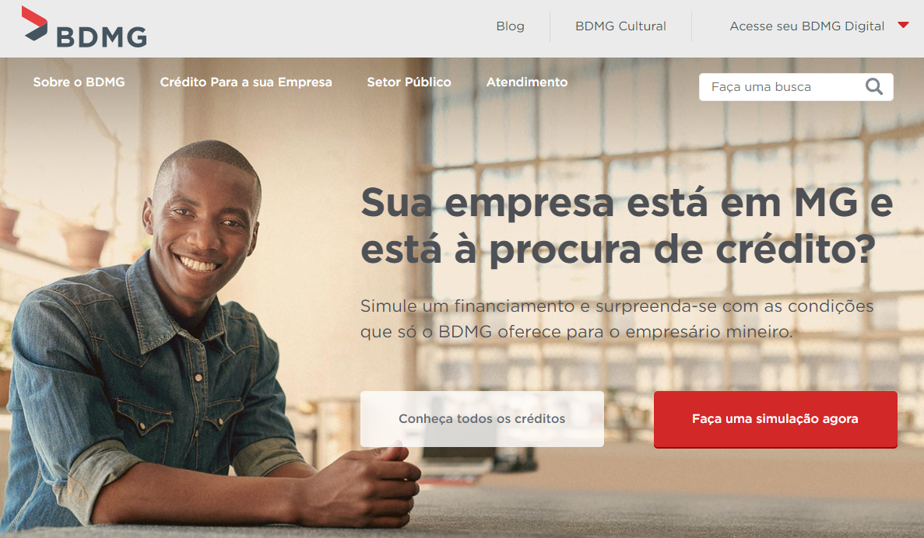
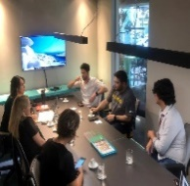
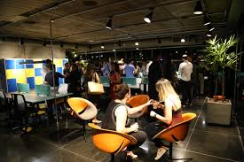
STRATEGY
BDMG’S NON-FINANCIAL INSTRUMENTS
MICRO & SMALL BUSINESS
4.554
Average nº of MSMEs per year in the last 4 years
Partnership for financial education
Credit combined with update on management and financial education
Financial inclusion
50% of MSMEs clients only have credit access from BDMG
INNOVATION HUB
BDMG’s Hubble is a space for open innovation
The focus is to growth and expand startups in a connecting environment to speed up business achievement
In 1Q 2019, 15 startups were selected and began their activities

Slide 9
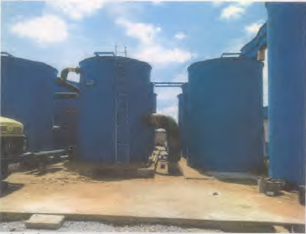
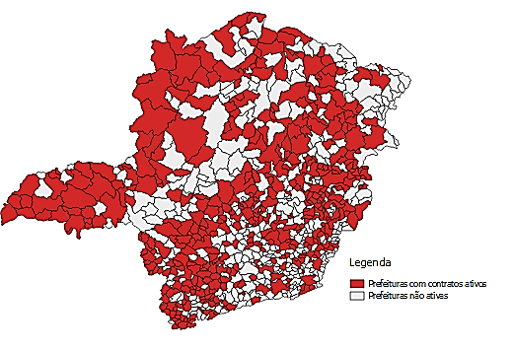
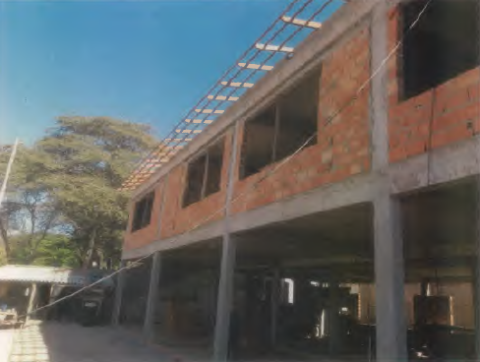
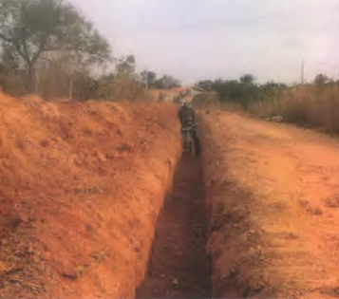
STRATEGY
BDMG’S NON-FINANCIAL INSTRUMENTS
MUNICIPALITIES
Boa Esperança
Water treatment
445
municipalities with active contracts in 1Q 2019
Sarzedo
Early Childhood Education Center
Jequitibá
Sewage treatment station
municipalities with active contract
BDMG supports municipalities in approving their projects, as well as providing loans for their execution
Water supply and sanitation systems, solid waste collection and management, urban infrastructure, purchase of machinery, equipment, institutional modernization, and school buses.

Slide 10
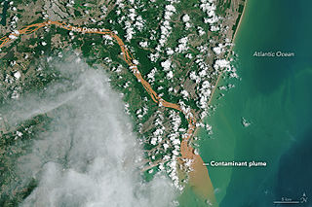
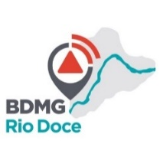
FUNDAÇÃO RENOVA
Atualmente há 04 fundos em operação:
Desenvolve Rio Doce
capital de giro para MPE, com taxas de juros abaixo da média do mercado.
Já foram liberados cerca de R$ 20,0 milhões para mais de 500 empresas da região;
Compete Rio Doce
executado em parceria com o Sebrae, financia a reestruturação financeira e de gestão de micro e pequenas empresas da região em situação de vulnerabilidade.
Em 06 meses de operação já foram atendidas quase 150 empresas.
Diversifica Mariana
fundo de equalização de taxa de juros para atração de empreendimentos para a cidade de Mariana
Hoje há duas empresas em fase de negociação, com previsão de investimentos da ordem de R$ 60 milhões, com potencial de geração de cerca de 2.000 empregos na região
Saneamento básico e resíduos sólidos
Destinando R$ 390 milhões para os municípios realizarem projetos voltados para melhoria da qualidade da água do Rio Doce
Há ainda em desenvolvimento parcerias na área de reflorestamento, investimentos municipais em educação, saúde, infraestrutura e segurança pública, bem como financiamento para MEI e realização de investimentos privados na região (escrevi, mas é importante decidir se quer falar esta parte, pois ainda estamos em fase de negociação).
STRATEGY
BDMG’S NON-FINANCIAL INSTRUMENTS
PUBLIC SECTOR ADVISORY
BDMG coordinates technical, legal, economic and financial modeling in concessions and PPPs for major projects
Sewage
Tourism
Education
Public security
Expansion of water distribution networks and sewage systems
Operation of state parks and tourist attractions
School´s construction and operation
Road monitoring
PARTNERSHIP FOR STRUCTURING FINANCIAL SOLUTIONS
Repair and compensation for the population affected by the rupture of the Fundão dam in Mariana in 2015
Funds in operation:
+650 MSMEs supported in Rio Doce region
1. Desenvolve Rio Doce
2. Compete Rio Doce
3. Diversifica Mariana
4. Sewage and solid waste
+ BRL 390 million available for affected
municipalities
+ BRL 20 million disbursed

Slide 11
STRATEGY
BDMG’S NON-FINANCIAL INSTRUMENTS
[POTENCIAL INITIATIVES AND FUTURE OPPORTUNITIES]
STRUCTURING PROJECTS IN PARTNERSHIP WITH MULTILATERAL BANKS
CROWD-IN PRIVATE CAPITAL
Help to crowd-in the private sector and anchor PPP Projects, particularly for large infrastructure financing to ensure market viability
Find innovative ways to crowd-in private capital, including by developing credit guarantee schemes, credit enhancements on capital market instruments, or matching private equity funds
A subnational development bank, like BDMG, should help MDBs to structure local projects with its existing capacity
Risk mitigation and/or risk sharing
Improved project design
Better development outcomes
Environmental, social, and governance standards
ADDITIONALITY PRINCIPLE

Slide 12
Sergio Gusmão Suchodolski
PRESIDENT

